Slide 1
Deep Learning-Image Classification with CNN
Group 4
Armando Lopo
Felipe Franca Doria
Quincy Ejaita

Slide 2
Our finely-tuned model achieves an accuracy of 84% on the test set, with a test-set loss of 0.47.
We tested 19 models.
Fine-tuned the model with a test accuracy of 84% and a test loss of 0.47 with only 277k parameters.
VGG19 with 2 unfrozen layers got 85% of test accuracy and 0.50 of test loss.
We connected our model to Gradio and tested it on classifying our own pets.

Slide 3
The CIFAR-10 dataset is perfectly balanced.
We looked at the shapes of our training and testing data and realized that the second, third, and fourth columns of X will be our input format for the NN.
X_train: (50000, 32, 32, 3)
X_test: (10000, 32, 32, 3)
y_train: (50000, 1)
y_test: (10000, 1)
We also took a look at the dataset classes and found out they are all perfectly balanced.

Slide 4
The CIFAR-10 dataset was well-structured and required no preprocessing.
We normalized the features for training and testing
X_train = X_train.astype('float32')/255.0
X_test = X_ test.astype('float32')/255.0
Made the target categorical for training and test
num_classes = 10
y_train_ohe = to_categorical(y_train, num_classes)
y_test_ohe = to_categorical(y_ test, num_classes)
The load already split the data into 50,000 training and 10,000 for testing.
(X_train, y_train), (X_test, y_test) = cifar10.load_data()
When fitting our models, we select 10 % of the training as a validation
challenger8.fit(X_train, y_train_ohe, validation_split=0.1, epochs=80, batch_size=128, callbacks=[early_stop, reduce_lr], verbose=1)

Slide 5
The team demonstrated strong compatibility, and all deliverables and goals are completed on time.
Workflow plan
Planned pipeline: data - preprocessing - split - CNN - tuning - transfer learning - presentation.
We added a daily tracker + quick check-ins to re-prioritize fast and maintain good pacing.
Teamwork
Daily visibility (X = idone, O = in-progress, ‘-’ = not started) kept everyone aligned and prevented duplicate work
Risk management
Risks: long training time, overfitting/weak generalization, and version/merge conflicts
Mitigation: early baseline + validation tracking (early stopping), frequent check-ups, and updates on model tweaks and changes

Slide 6
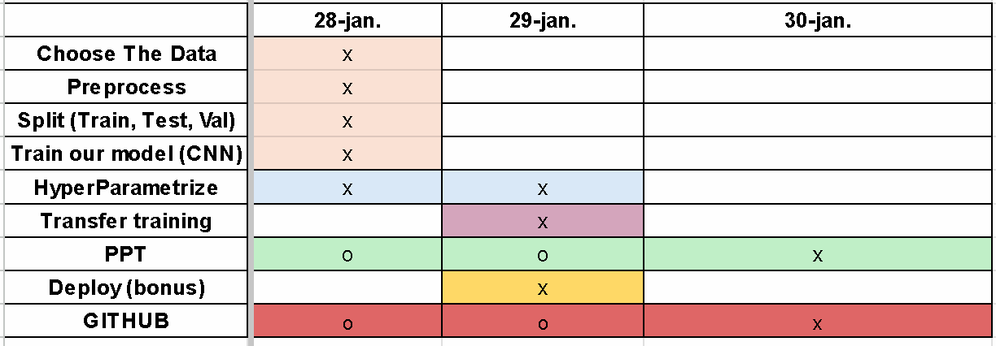
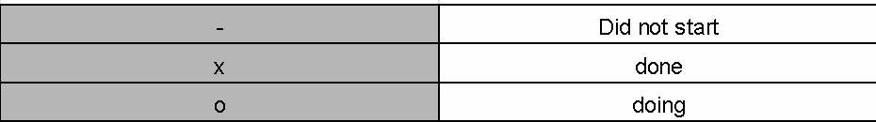
Deliverables timeline.

Slide 7
Major obstacles is time and experience.
There were many obstacles, but the main ones were:
Time.
Experience.
This was interesting and motivating

Slide 8
Conclusion and insights
Our finely-tuned model achieves an accuracy of 84% on the test set, with a test-set loss of 0.47.
We could get more accuracy and a smaller loss if we used more neurons or triedto fine tune the transfer model better.
We connected our model to Gradio and tested it on classifying our own pets.

Slide 9
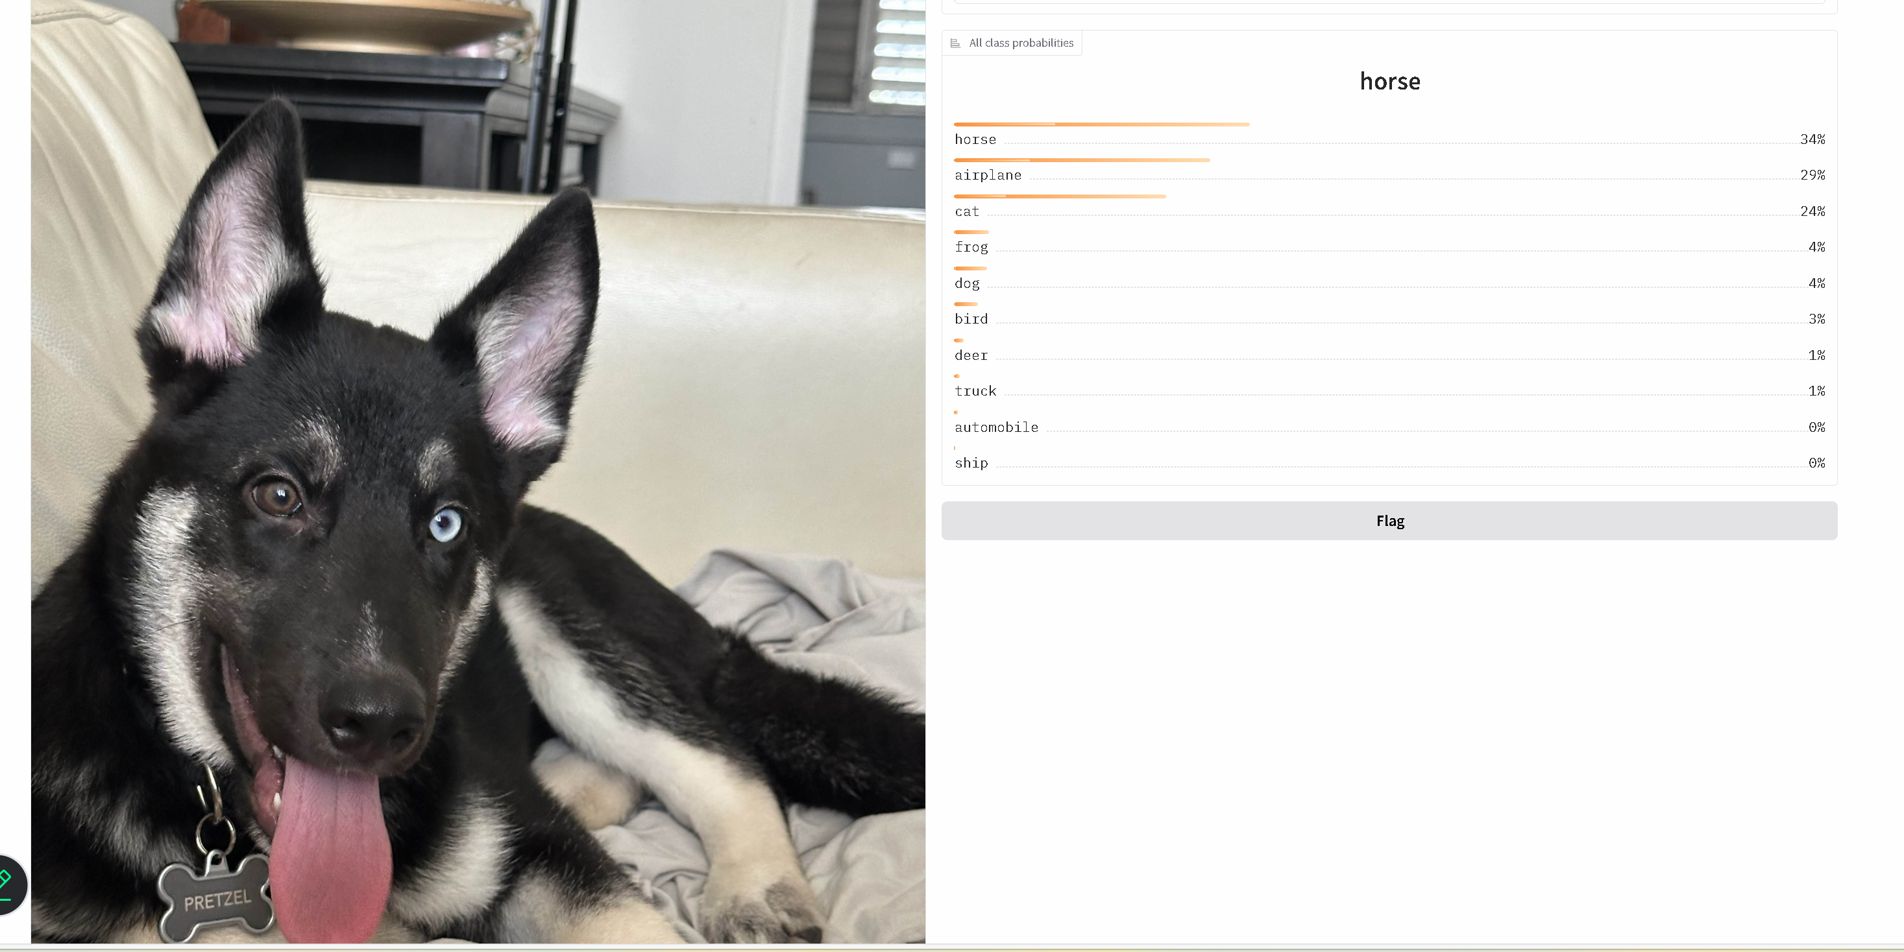
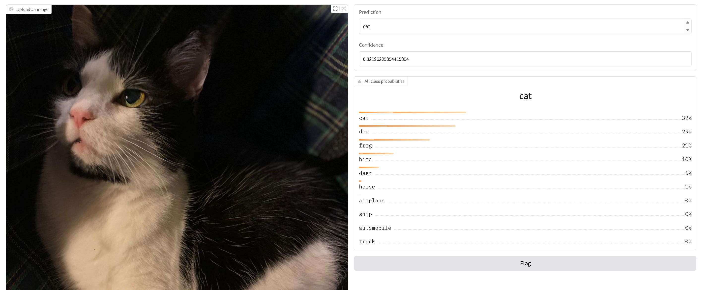
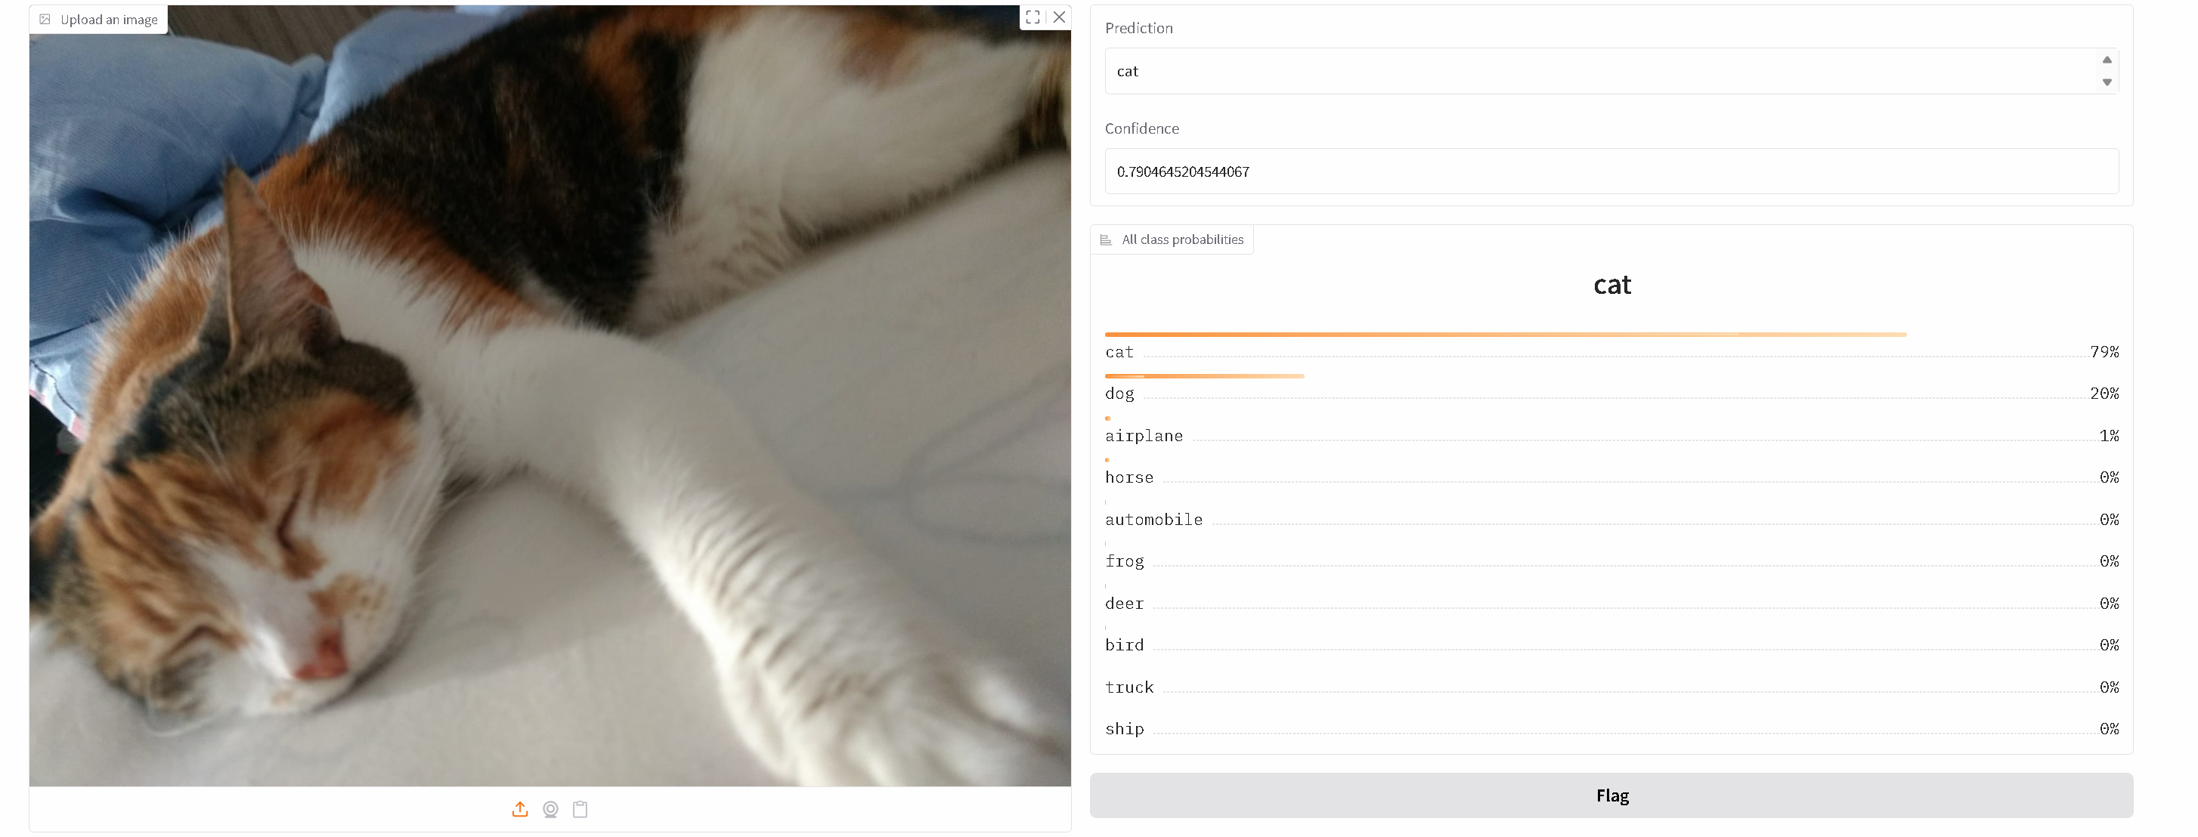
Results

